Slide 1


CYBERPATRIOT
NATIONAL YOUTH CYBER EDUCATION PROGRAM
AIR FORCE ASSOCIATION’S
UNIT 10
Ubuntu Security
www.uscyberpatriot.org
© Air Force Association’s CyberPatriot Program

Slide 2
Learning Objectives
Participants will understand how to configure major components of
Linux/Ubuntu
Account management
Updates
Firewall
Participants will understand how to implement user-level configurations
within Ubuntu
Account settings
Group configuration
Authentication and the PAM file
Participants will understand commands that will be useful for securing a Linux machine
Participants will understand system and audit logging
Overview
Configuration
www.uscyberpatriot.org
2
© Air Force Association’s CyberPatriot Program

Slide 3

CYBERPATRIOT
NATIONAL YOUTH CYBER EDUCATION PROGRAM
AIR FORCE ASSOCIATION’S
SECTION 1
Basic GUI Security
www.uscyberpatriot.org
© Air Force Association’s CyberPatriot Program

Slide 4
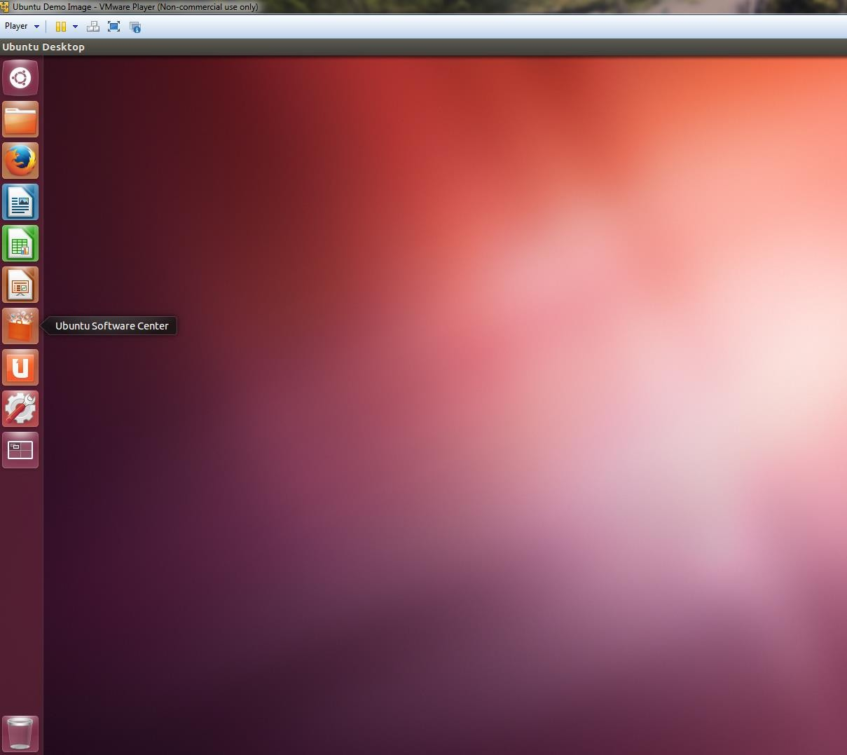
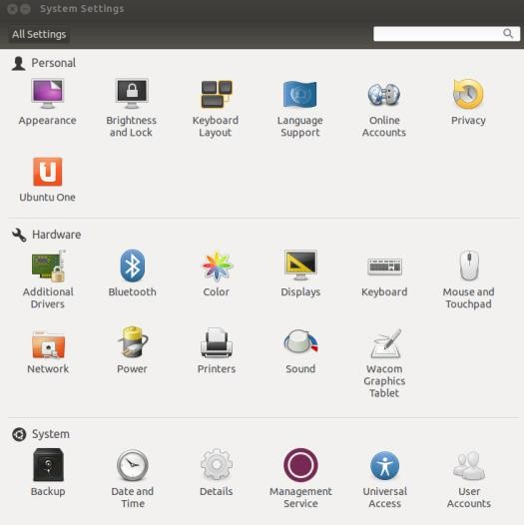
Basic Linux Security
This unit will show you how to make many of the same security settings you made on Windows in Units 7 and 8
– Linux has many of the same vulnerabilities, so the fixes are similar
Linux does not have Settings or Control Panel like in Windows
The System Settings menu
offers limited security tools
Click the System Settings button in the menu bar
www.uscyberpatriot.org
‹#›
© Air Force Association’s CyberPatriot Program

Slide 5
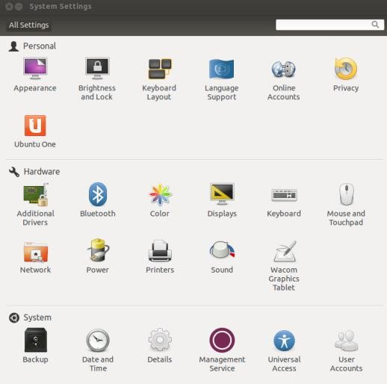
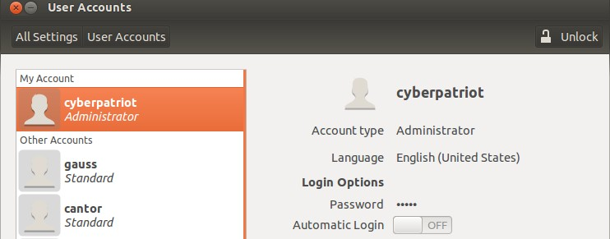
User Accounts Overview
A.
1.
2.
B.
C.
Click User Accounts in the System Settings window
As in Windows, it is important to restrict root (Admin) privileges and password protect all accounts
To make account management changes, you must enact root permissions by clicking
Unlock and authenticate yourself by entering your password
Switch users from Administrator to Standard User by clicking next to Account Type
Change passwords by clicking the asterisks next to the Password option
www.uscyberpatriot.org
‹#›
© Air Force Association’s CyberPatriot Program

Slide 6
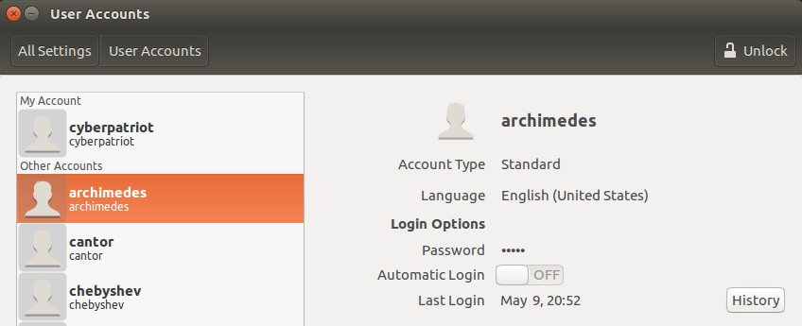
User Accounts – Account Type
Select the user archimedes
To make changes, click Unlock and authenticate
Keep Automatic Login set to off
The user account type can be changed by clicking the field next to Account Type
www.uscyberpatriot.org
© Air Force Association’s CyberPatriot Program
‹#›

Slide 7
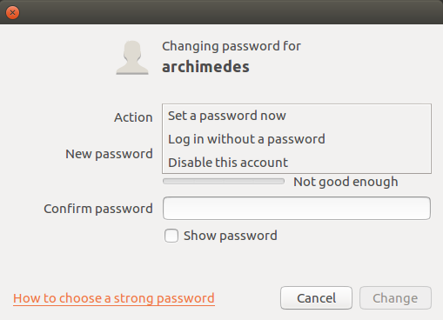
User Account -- Passwords
Click the field next to Password
– Set a password now allows you to change a user’s password
– Do not select Log in without a password
– The third option allows you to disable or enable an account
Press Cancel to return to the User Accounts windows
www.uscyberpatriot.org
© Air Force Association’s CyberPatriot Program
‹#›

Slide 8
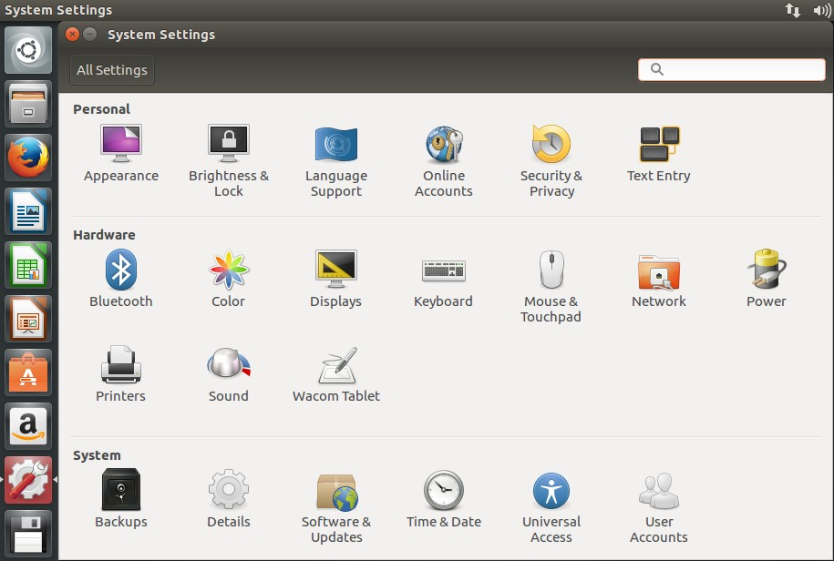
Configuring Updates
Click Software & Updates in the System Settings window
www.uscyberpatriot.org
© Air Force Association’s CyberPatriot Program
‹#›

Slide 9
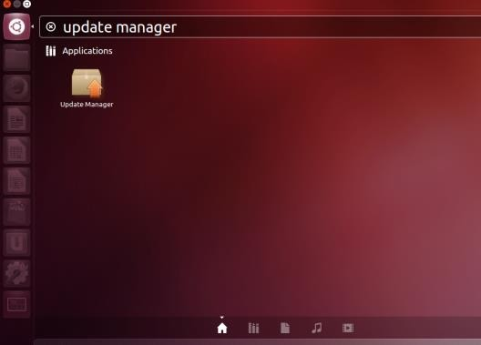
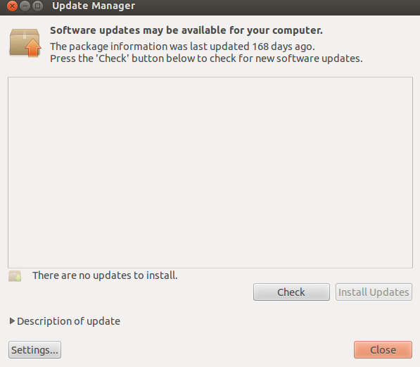
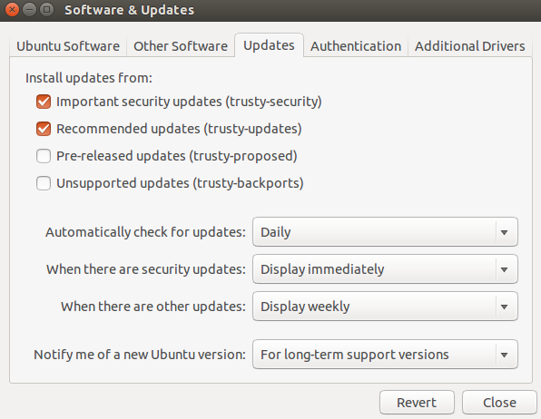
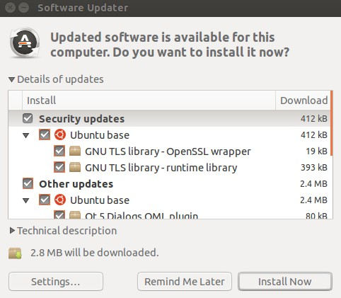
Installing Updates Overview
The open-source community regularly develops improvements and patches for Ubuntu
You should install these updates regularly
1.
2.
Click the Ubuntu button in the menu bar and search for Update Manager
Click Settings on the Update
Manager Screen
To set automatic updates, go to the Updates Tab and make sure “Automatically check for updates” is set to “Daily”
After applying the changes, install any available updates from the main Update Manager window
3.
4.
www.uscyberpatriot.org
9
© Air Force Association’s CyberPatriot Program

Slide 10
Configuring Updates
Click Software & Updates in the System Settings window
www.uscyberpatriot.org
© Air Force Association’s CyberPatriot Program‹#›

Slide 11
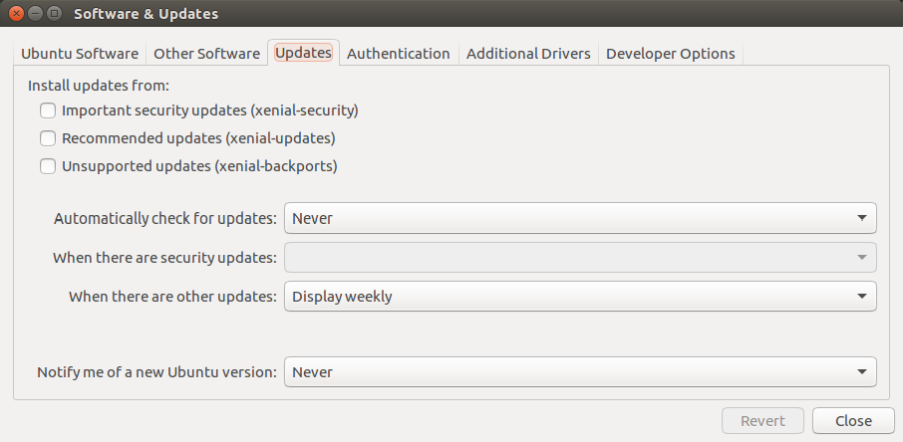
Update Policy
Three Important Tabs
Ubuntu Software
Other Software
Updates
www.uscyberpatriot.org
© Air Force Association’s CyberPatriot Program‹#›

Slide 12
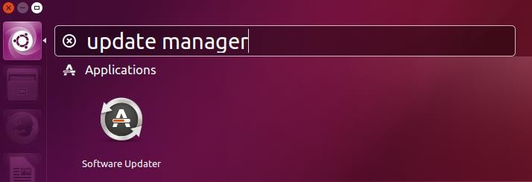
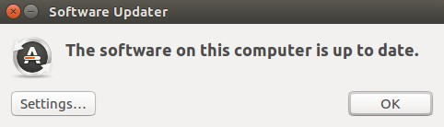
Installing Updates
Click the Ubuntu button in the left-hand menu and search for Update Manager
www.uscyberpatriot.org
© Air Force Association’s CyberPatriot Program‹#›

Slide 13
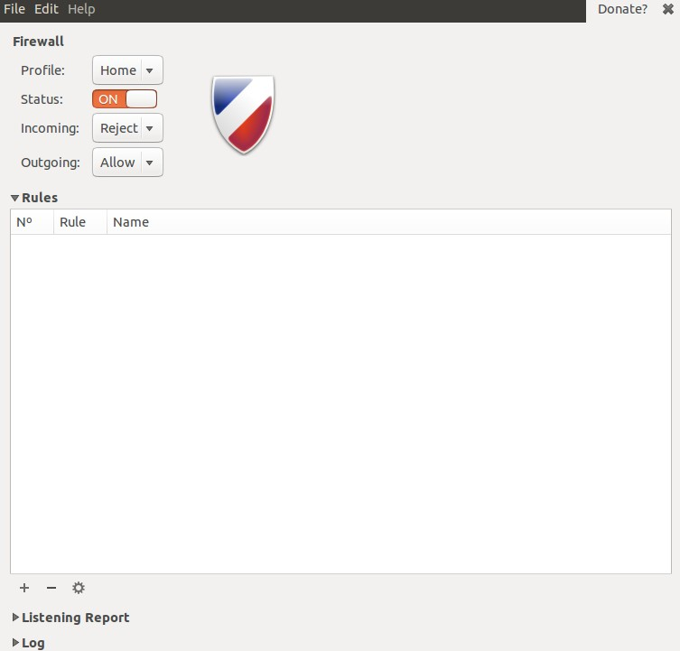











Enabling the Firewall
Enable the Ubuntu Built-in Firewall (UFW) to prevent unauthorized access to the computer
The UFW is deactivated by default
By default, UFW is only accessible by
command line
You can download Gufw, a graphical firewall interface, from the Software Center and use it to make changes to the UFW in the GUI
You might need to install Ubuntu updates
before installing Gufw
Source: https://help.ubuntu.com/community/UFW
www.uscyberpatriot.org
© Air Force Association’s CyberPatriot Program

Slide 14
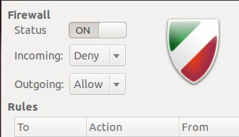
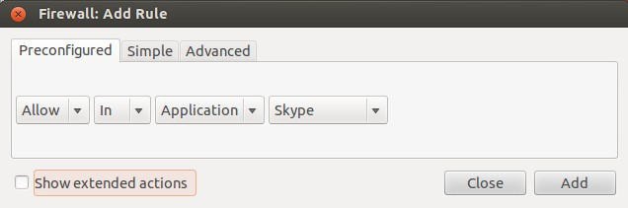
Using Gufw
After downloading Gufw from the Software Center, click the Ubuntu button in your menu bar → Search → Firewall Configuration
Click the Unlock button on the Gufw window → Enact root
permissions by authenticating → Turn Firewall Status On
The default (and recommended) rules governing traffic are
to Deny all incoming traffic and Allow all outgoing traffic
The Reject option is the same as Deny, but also sends a notification to the sender that connection has been blocked
The Preconfigured rule panel allows incoming and/or outgoing traffic to be controlled for certain applications or services
‐ Similar to the Windows Firewall Exceptions list
‐ Open entire ports by clicking the Simple or
Advanced tabs
Source: https://help.ubuntu.com/community/Gufw
www.uscyberpatriot.org
© Air Force Association’s CyberPatriot Program

Slide 15
CYBERPATRIOT
NATIONAL YOUTH CYBER EDUCATION PROGRAM
AIR FORCE ASSOCIATION’S
SECTION 2
Basic Command Line Security
www.uscyberpatriot.org
© Air Force Association’s CyberPatriot Program

Slide 16

The Password file
/etc/passwd
Usually does not contain passwords (anymore)
Contains user information
Type cat /etc/passwd
Type man 5 passwd to view the manual for the password file
– When you are done, press q to quit
www.uscyberpatriot.org
© Air Force Association’s CyberPatriot Program‹#›

Slide 17
The Password File
User Name
User ID
Password Group ID
User Name
The name associated with this user account
This is primarily used by humans to identify a user account
Password
x denotes password is stored in shadow file
User ID – Numerical user ID, or “UID”
The OS internally identifies users using their UID not Username
Group ID – Numerical primary group ID, or “GID”
www.uscyberpatriot.org
© Air Force Association’s CyberPatriot Program‹#›

Slide 18
The Password File
User Name
User ID
Comment
Home
Directory
Shell
Password Group ID
Comment
Typically used to store the users “real name”
Home Directory
The current working directory when this user log in
Shell
The shell (or command) that gets executed when you log in
How this user interacts with the computer when logging in on the command line
www.uscyberpatriot.org
© Air Force Association’s CyberPatriot Program‹#›

Slide 19
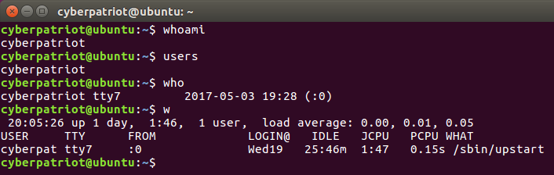
Listing Users
Try running the following commands in the terminal:
whoami
Prints your current username
users
Prints the user names of users currently logged in to the current host
who
Prints information about users who are currently logged in
w
Displays information about the users currently on the machine, and their processes
www.uscyberpatriot.org
© Air Force Association’s CyberPatriot Program‹#›

Slide 20
The gedit Command
Gedit is one of many text editor commands in Ubuntu
Syntax: gedit [filepath]
Unlike with other text editors, using gedit will cause a second
window to pop-up where you can easily change the text of a file
This command will allow you to edit security policy files
You need to enact root permissions before using gedit to edit files that cannot be
accessed by standard users (e.g. system and security files)
When using gedit for the first time, go to Edit → Preferences → Uncheck “Create a
backup copy of files” to avoid saving issues
Try using gedit by opening Terminal and entering gedit hello2.txt
You will not be prompted to authenticate because this is a public
file
www.uscyberpatriot.org
© Air Force Association’s CyberPatriot Program

Slide 21
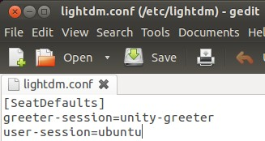
Using gedit to Turn off the Guest Account
Like in Windows, the Ubuntu guest account is turned on by default
You should disable it so people can’t access the computer anonymously
The guest account is controlled by LightDM, the display manager controlling the Ubuntu
login screen
To turn off the guest account, edit the LightDM file:
After root authenticating, type gedit /etc/lightdm/lightdm.conf
Add the line allow-guest=false to the end of the Light DM file that pops up and click Save
Restart your system and click your username button in the top-right corner of your desktop. The guest
account should be disabled.
Sources: https://help.ubuntu.com/8.04/serverguide/C/user-management.html,
http://askubuntu.com/questions/451526/removing-guest-session-at-login-in-ubuntu-14-04
www.uscyberpatriot.org
© Air Force Association’s CyberPatriot Program

Slide 22
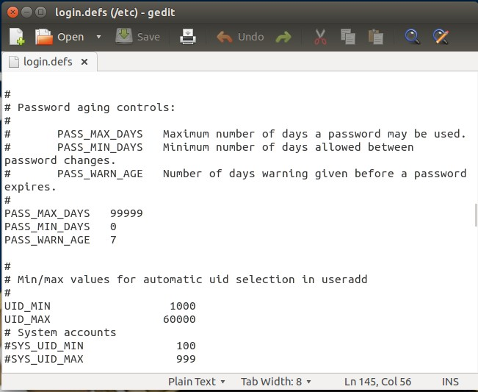
Using gedit to Edit Password History
Type gedit /etc/login.defs
This is a much longer file. To easily find the section to edit, type Ctrl+F and then “PASS_MAX_AGE”
Modify the following variables to the same
recommended settings used in Windows:
Maximum Password Duration:
PASS_MAX_DAYS 90
Minimum Password Duration:
PASS_MIN_DAYS 10
Days Before Expiration to Warn Users to Change Their Password:
PASS_WARN_AGE 7
Save the file and close it
Sources: http://xmodulo.com/2013/12/set-password-policy-linux.html,
www.uscyberpatriot.org
© Air Force Association’s CyberPatriot Program

Slide 23
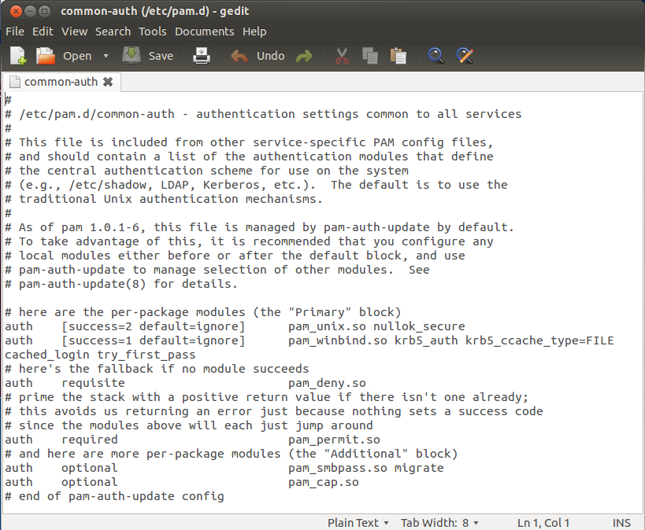
Using gedit to Set Account Policy
Type gedit /etc/pam.d/common-auth
This file allows you to set an account lockout policy
Add this line to the end of the file:
auth required pam_tally2.so deny=5 onerr=fail unlock_time=1800
Save the file and close it
Sets the number of allowed failed login attempts (in this case 5)
Sets the account lockout duration in seconds (in this case, 30 minutes)
Source: http://linux.die.net/man/8/pam_tally
www.uscyberpatriot.org
© Air Force Association’s CyberPatriot Program

Slide 24
CYBERPATRIOT
NATIONAL YOUTH CYBER EDUCATION PROGRAM
AIR FORCE ASSOCIATION’S
SECTION 3
Advanced Ubuntu Security
www.uscyberpatriot.org
© Air Force Association’s CyberPatriot Program

Slide 25
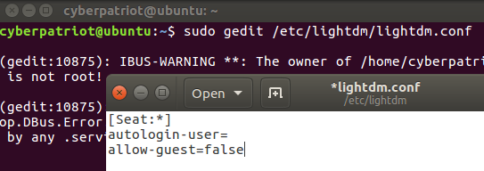
Turn off the Guest Account
Turned on by default
LightDM: display manager controlling the login screen
Type sudo gedit /etc/lightdm/lightdm.conf
Add the line allow-guest=false under [Seat:*]
www.uscyberpatriot.org
© Air Force Association’s CyberPatriot Program‹#›

Slide 26
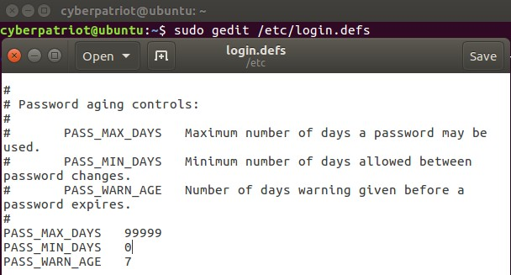
Password Age Policy
In a terminal, type sudo gedit /etc/login.defs
Maximum Password Duration: PASS_MAX_DAYS Minimum Password Duration: _{PASS_MIN_DAYS} Password Warning Before Expiration: _{PASS_WARN_AGE}
90
5
7
www.uscyberpatriot.org
© Air Force Association’s CyberPatriot Program‹#›

Slide 27
The chmod Command
Chmod allows you to change file permissions
Change permissions for the user, group, or others
Add or subtract
permissions
Specify whether read, write, or execute privileges are being changed
Syntax: chmod [u,g or o][+ or -][r,w, or x] [filepath]
– Do not put spaces between the three fields after “chmod”
Example:
Type chmod o-r hello2.txt
Type ls –l hello2.txt
If your permissions originally matched those on the last slide, you should see hello2.txt’s new file permissions as shown below
hello2.txt
Sources: http://condor.depaul.edu/dpowebpg/support/chmod.html, https://help.ubuntu.com/community/FilePermissions
www.uscyberpatriot.org
© Air Force Association’s CyberPatriot Program

Slide 28
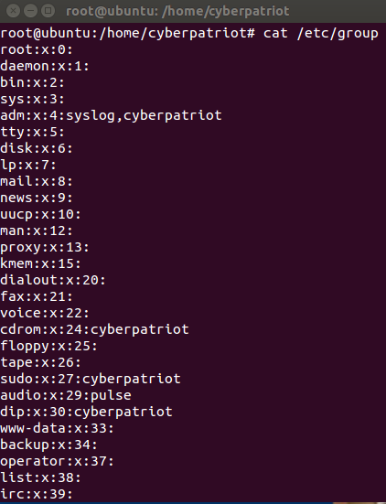

Groups
Work very similarly to Windows
– Root permissions are required
To list all groups:
cat /etc/group
To add a group:
addgroup [groupname]
To add a user to a group:
adduser [username] [groupname]
www.uscyberpatriot.org
© Air Force Association’s CyberPatriot Program

Slide 29
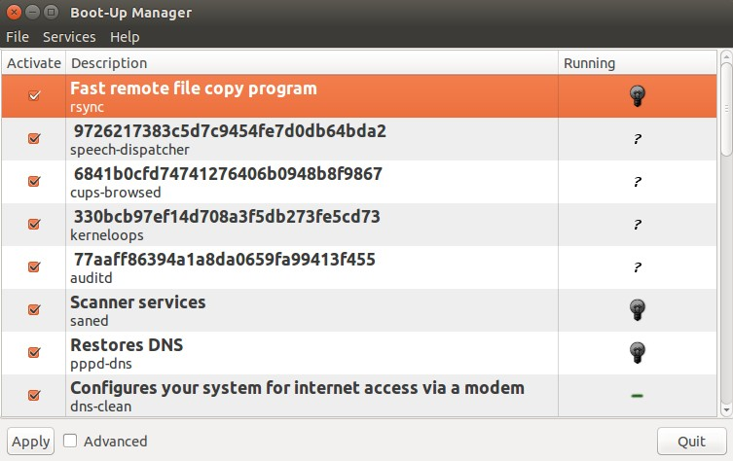
Services
Can be viewed and managed in the GUI
To install, type apt-get install bum in Terminal
After installing, type bum to run
To start a service, right-click it and select “Start”
When a service is started, the light bulb will light up. When stopped, the light bulb will be dark.
To enable a service, check the box next to it
www.uscyberpatriot.org
© Air Force Association’s CyberPatriot Program

